Slide 1
Mạng thông tin di động 3G
UMTS / W-CDMA
(Universal Mobile Telecommunications System)
ξ 3. Kênh tại giao diện vô tuyến Uu

Slide 2
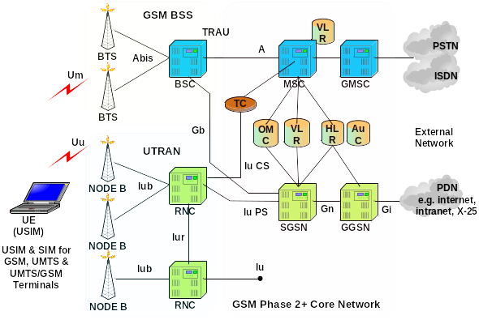

UMTS Network Architecture

Slide 3
Radio Interface - protocol architecture
C-plane
U-plane
L3
L3: Radio Network Layer
RRC
LAC
L2/LAC
LAC
LAC
L2: Radio Link/Access
Control + Media Access
Control
Logical
channels
RLC
RLC
RLC
RLC
L2/MAC
MAC
Transport
channels
L1
Physical Layer
L1: Radio Physical Layer
Notes:
The relationship between the mobile and the network is normally seen through the radio interface. It specifies how the information that has to be exchanged between those two entities (both user data and signalling information) has to be organised in a layered framework. Note that the radio interface is not directly specifying the end points of each protocol layer in the network: the allocation of the protocol end-points termination obeys network efficiency and performance criteria that will be discussed.
The physical layer implements all the services and functions needed for the transfer of signalling and data information; from a radio resource viewpoint, the basic role of L1 is to map the transport channels to the radio physical channels.
The MAC layer offers the transport service to the upper layers, in line with the defined attributes.
The Radio Link Control Protocol (RLC) offers services and functions that are ensuring the correctness of the data transfer (ARQ functions) and performs the data segmenting/re-assembling features. This protocol could in principle be embedded in the MAC protocol.
The presence of a Layer 2/LAC (Link Access Control) level is still under discussion in ETSI. Its role could consist in supplying retransmission features mainly in relation to handover and macrodiversity requirements, whenever they cannot be supplied by the RLC Protocol. The option of having a second ARQ layer depends on the archirectural solutions that will be adopted for the handover and macrodiversity resolution.
Layer 3 contains, at least in the radio access segment on the C-Plane, services and functions related to the control of the radio resources.

Slide 4
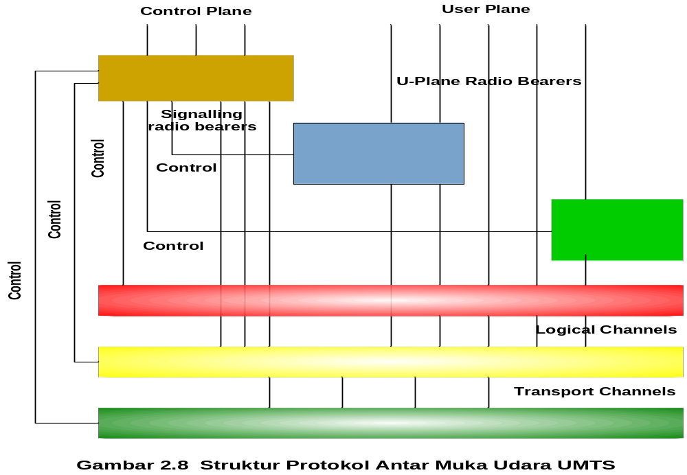
UMTS Protocol Architecture

Slide 5
Logical, Transport and Physical channels
Logical channel: an information stream dedicated to the transfer of a specific type of information
Transport channel: described by how data are transferred
Physical channel: defined by the frequency, phase (I,Q) and code
UE
Node B
RNC
Logical Channels
Transport Channels
Physical Channels

Slide 6
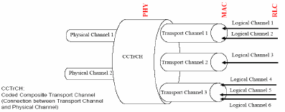
Logical, Transport and Physical channels

Slide 7
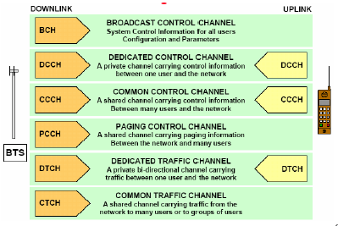
Logical Channel - UMTS
Node B
UE

Slide 8
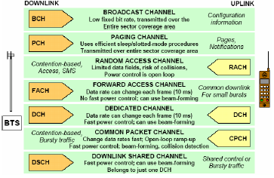
Transport Channel - UMTS
Node B
UE

Slide 9
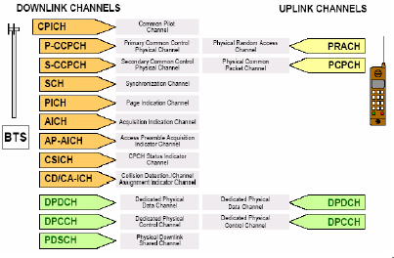
Physical Channel - UMTS
Node B
UE

Slide 10
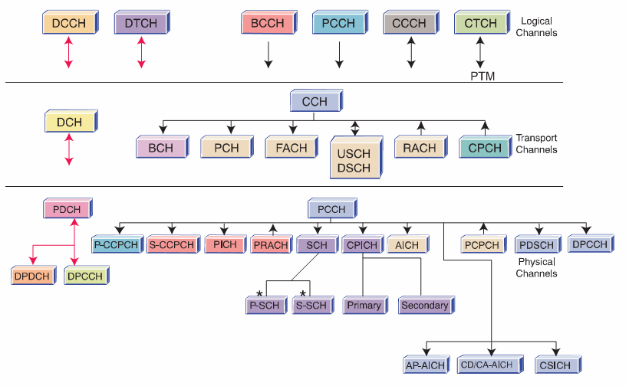
UMTS Channels

Slide 11
UMTS Logical Channels
Broadcast Control Channel (BCCH), Downlink (DL)
Paging Control Channel (PCCH), DL
Dedicated Control Channel (DCCH), UL/DL
Common Control Channel (CCCH), UL/DL
Dedicated Traffic Channel (DTCH), UL/DL
Common Traffic Channel (CTCH), Unidirectional (one to many)

Slide 12
UMTS Transport Channels
Dedicated Transport Channel (DCH), UL/DL, mapped to DCCH and DTCH
Broadcast Channel (BCH), DL, mapped to BCCH
Forward Access Channel (FACH), DL, mapped to BCCH, CCCH, CTCH, DCCH and DTCH
Paging Channel (PCH), DL, mapped to PCCH
Random Access Channel (RACH), UL, mapped to CCCH, DCCH and DTCH
Uplink Common Packet Channel (CPCH), UL, mapped to DCCH and DTCH
Downlink Shared Channel (DSCH), DL, mapped to DCCH and DTCH

Slide 13
UMTS Physical Channels
Primary Common Control Physical Channel (PCCPCH), mapped to BCH
Secondary Common Control Physical Channel (SCCPCH), mapped to FACH, PCH
Physical Random Access Channel (PRACH), mapped to RACH
Dedicated Physical Data Channel (DPDCH), mapped to DCH
Dedicated Physical Control Channel (DPCCH), mapped to DCH
Physical Downlink Shared Channel (PDSCH), mapped to DSCH
Physical Common Packet Channel (PCPCH), mapped to CPCH
Synchronisation Channel (SCH)
Common Pilot Channel (CPICH)
Acquisition Indicator Channel (AICH)
Paging Indication Channel (PICH)
CPCH Status Indication Channel (CSICH)
Collision Detection/Channel Assignment Indication Channel (CD/CA-ICH)

Slide 14
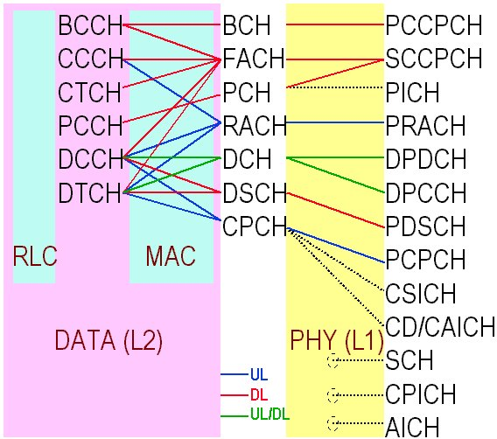
UMTS Channel Mapping

Slide 15
Layer 1 - up link physical channels
Data
Dedicated Physical
Data Channel
0.667 ms
Pilot
FBI
TPC
TFI
Dedicated Physical
Control Channel
Slot#1
Slot#2
Slot#i
Slot#15
frame
Frame#1
Frame#2
Frame#i
Frame#72
superframe
10 ms
FBI: FeedBack Indicator
TPC: Transmit Power Control
TFI: Transport Format Indicator
Notes:
Layer 1 services refer typically to the transport role; a transport channel is specified by the way (e.g. bit rate and delays) adopted to transport the data offered by the upper layers; this role is played by making use of physical channels, directly defined on the physical structure of the radio interface.
The example represents the up link physical channels under discussion in ETSI for the W-CDMA scheme.
On the up link, two type of physical channels are identified, namely dedicated physical channels and common channels.
The dedicated channels are:
the Dedicated Physical Data Channel (DPDCH) used to carry the data (user or control data) generated by the MAC and upper layers
the Dedicated Physical Control Channel (DPCCH) used to carry control information generated at Layer 1; specifically: pilot symbols for the channel estimate; transmission power control information and the transport format indicator (the latter specifies the configuration of encoding, interleaving, bit rate and physical channel mapping applied to the transport channels); in addition, DPCCH carries the feedback information channel, controlling the transmission diversity of the base station.
A single common channel is defined on the up link, namely the physical random access channel (PRACH), offering the early access capabilities to the MSs. The PRACH is based on a Slotted Aloha concept; the access slots are defined on the depicted frame structure and the broadcast channel reports the needed information about the PRACH that can be accessed in that particular cell.
Both DPDCH and DPCCH obey the frame structure depicted in figure; the frame is a 10 ms frame, split in 15 slots, each one lasting 0.667 ms, corresponding to a power-control period. The number of bits inserted in each slot depends on the spreading factor adopted in that particular instant.

Slide 16
Uplink Variable Rate
10 ms
1-rate
1/2-rate
1/4-rate
0-rate
Variable
rate
R = 1
R = 1/2
R = 0
R = 0
R = 1/2
: DPCCH (Pilot+TPC+RI)
: DPDCH (Data)
Notes:
Different connections can then use different rates and the rate of a connection can be changed along the connection itself. The Dedicated Channel has to be maintained in any case, due to the information it is carrying.
The change of bit rate may also imply the modification of the mapping between transport and physical channels, whose configuration is controlled through the Transport Format Indicator.
The basic chip rate for the ETSI proposal is 4.096 Mchips/s. Additional chip rates are specified for the FDD mode, namely 8.192 Mchips/s and 16.384 Mchips/s. These are for further evolution of the radio access towards services requiring a transmission capacity greater than 2Mbit/s.

Slide 17
Layer 1 - down link physical channels
DPCCH
DPDCH
Pilot
TPC
TFI
Data
0.667 ms
Slot#1
Slot#2
Slot#i
Slot#15
frame
Frame#1
Frame#2
Frame#i
Frame#72
superframe
10 ms
Notes:
Also for the down link, dedicated and common physical channels are foreseen. In the dedicated channels, data information generated at Layer 2 or above, are time-multiplexed with the control information generated at Layer 1 (pilot, power control and transport format indication).
The frame structure is the same as for the up link.
Whenever the total bit rate of a connection exceeds the maximum allowed bit rate for a single DPCH, a multi-code transmission is adopted, employing more than one DPCH for that connection; if a single spreading factor is used for each DPCH, the Layer 1 control information is associated to one only of the physical channels: the other does not transmit in the corresponding slot period.
The common physical channels defined on the down link are:
the primary Common Control Physical Channel used to carry the Broadcast Channel (BCH)
the secondary Common Control Physical Channels, used to carry the Forward Access Channel (FACH) and the Paging Channel (PCH); FACH is used to transmit mobile specific control information and short packets.
Both primary and secondary common channels obey the frame structure described for the dedicated channels; the only difference is that for the Common Channels, the single slot includes only two data fields, containing the pilot and the data information respectively; both primary and secondary control channels adopts a fixed bit rate, which is defined at system level for the former and at a cell level for the latter (the cell BCCH informs the roaming mobiles about the secondary channel bit rate). A primary and a secondary synchronisation channels are defined on the down link and transmitted with specific codes synchronously with each BCH slot; the former is unique for all the system, the latter identifies the scrambling code associated to the specific station.

Slide 18
Downlink Variable Rate (DTX based)
0.625 ms
1-rate
1/2-rate
1/4-rate
0-rate
: DPCCH-part (Pilot+TPC+RI)
: DPDCH-part (Data)
Notes:
On the down link, Data and Control channels are time multiplexed. With the same spreading factor, variable bit rate within the same Physical Channel is managed through a discontinuous transmission mechanism, as depicted in the figure.
High bit rate connections require, as seen, multi-code transmission using more than one Physical Channel.

Slide 19
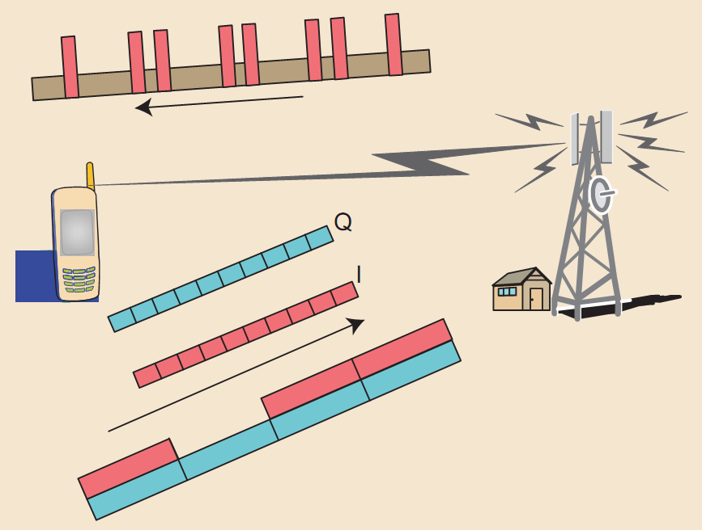
Notes:
On the down link, Data and Control channels are time multiplexed. With the same spreading factor, variable bit rate within the same Physical Channel is managed through a discontinuous transmission mechanism, as depicted in the figure.
High bit rate connections require, as seen, multi-code transmission using more than one Physical Channel.

Slide 20
Multiplexing transport channels onto physical channels
trasport channels
multiplexing
DCH
coding
interleaving
rate
matching
DCH
interleaving
rate
matching
multiplexing
interleaving
DCH
rate
matching
dynamic
(up link)
intra frame
interleaving
coding
interleaving
interleaving
DCH
static
inter frame
interleaving
Notes:
At Layer 1, the Dedicated Transport Channel, in general undergoes some processing before being mapped to physical channels and transmitted (after spreading); the basic process steps are shown in the figure.
Several transport channels can be multiplexed before being mapped to one or more physical channels.
Channel coding is performed in general per each transport channel independently; several options are available for the coding algorithm (convolutional, Reed-Solomon, turbo coding) that can possibly be use in conjunction. Different transport channels can possibly be interleaved.
The static rate matching is performed at a slow pace, typically when a transport channel is added or removed from the pool of jointly transmitted transport channels. This process is done in order to fulfil the transmission quality requirements of each transport channel, by maintaining at the same time a uniform bit energy per each channel. Another role of the static rate matching is to adjust the (coded) channel bit rate in accordance with the available bit rate of the dedicated physical channels.
The dynamic rate matching is performed on the up link, after multiplexing, to adapt the instantaneous bit rate of the multiplexed transport channels to the bit rate of the dedicated physical channel(s); on the down link, DTX is used to cope with bit rate misalignments; both static and dynamic rate matching use unequal repetition techniques.
The transport channel multiplexing is performed on a time-division basis, within a radio frame.
Inter frame interleaving is performed within a single transport channel over more than one frame for those services that require this kind of mechanism; intra frame interleaving is performed on a single frame and can apply to multiplexed transport channels.

Slide 21
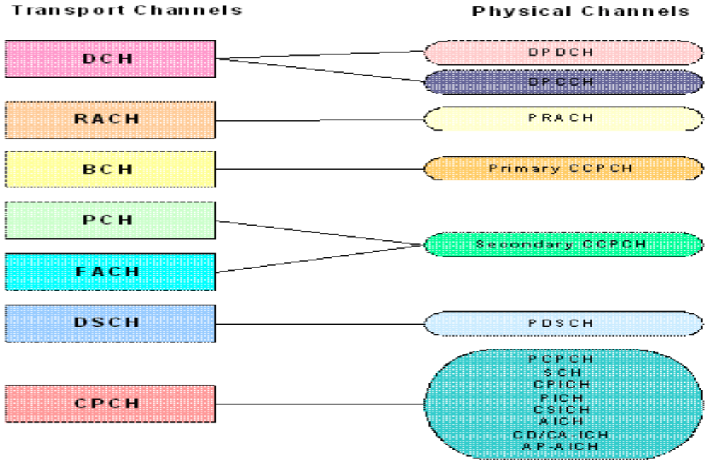
Mapping transport channels onto physical channels

Slide 22
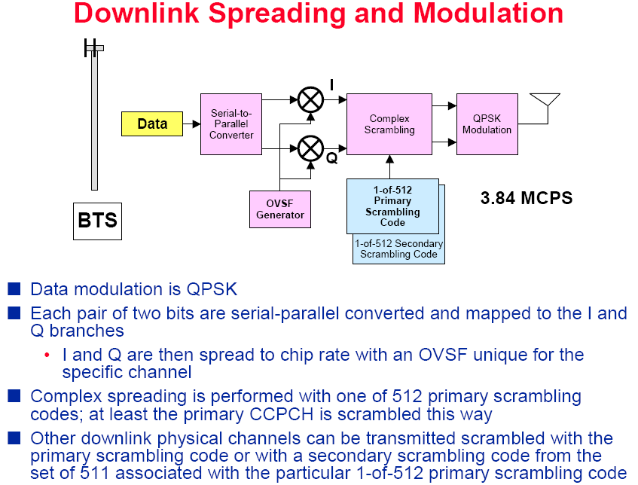
Node B

Slide 23
Node B

Slide 24
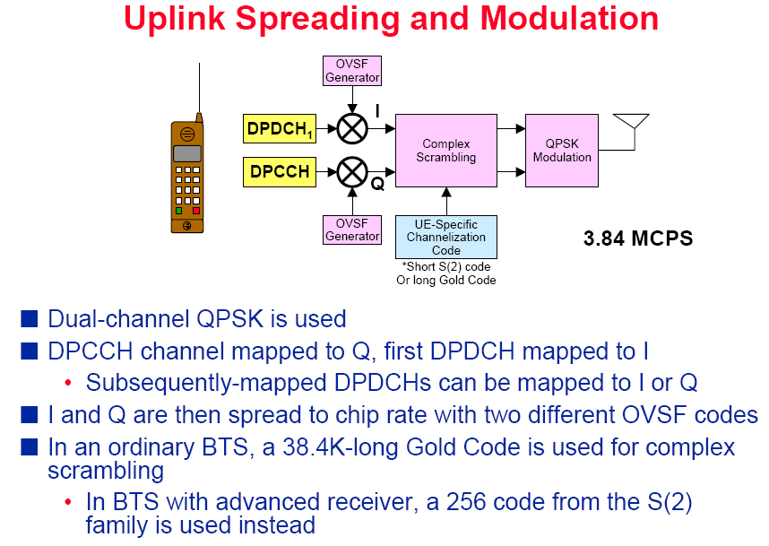

Slide 26
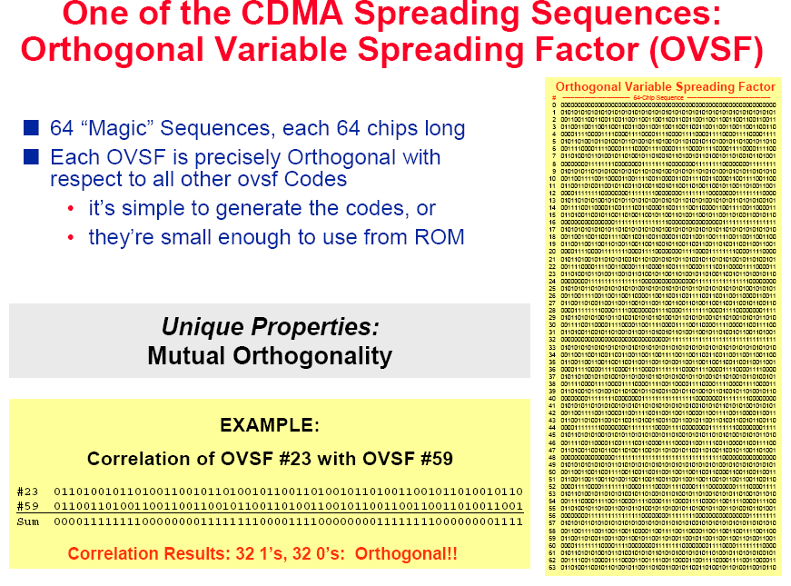

Slide 27
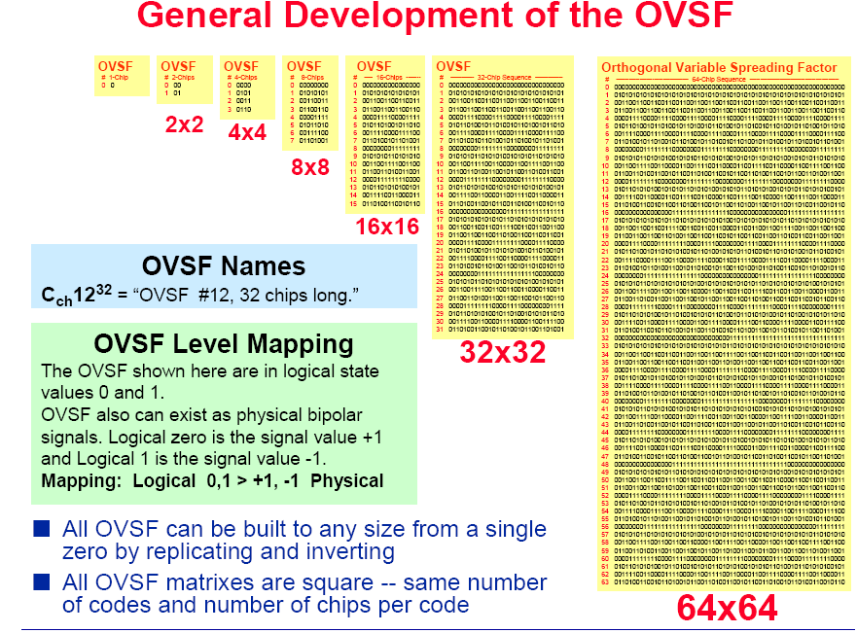

Slide 28
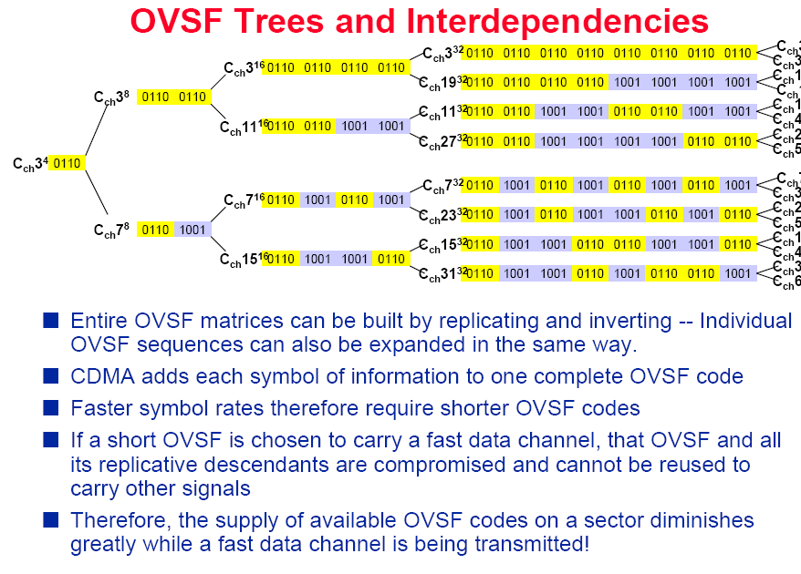

Slide 29
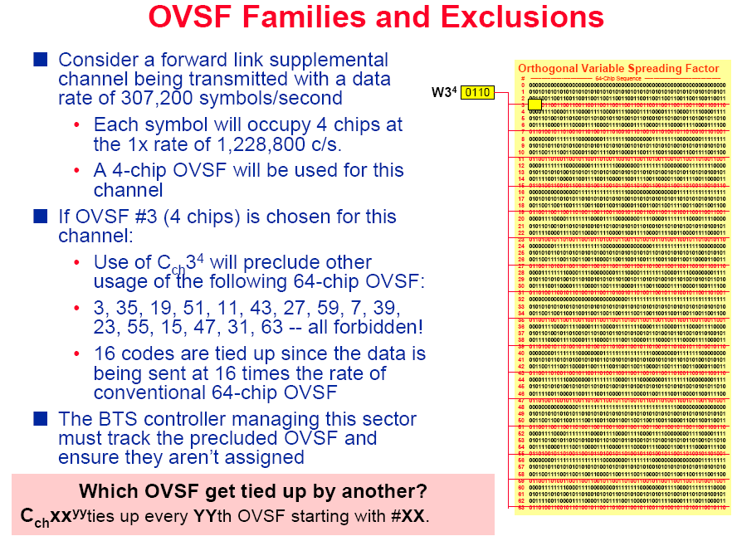

Slide 30
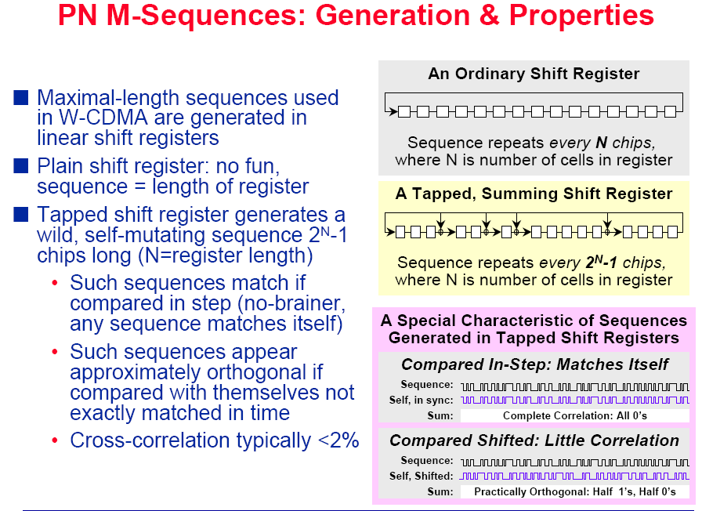

Slide 31
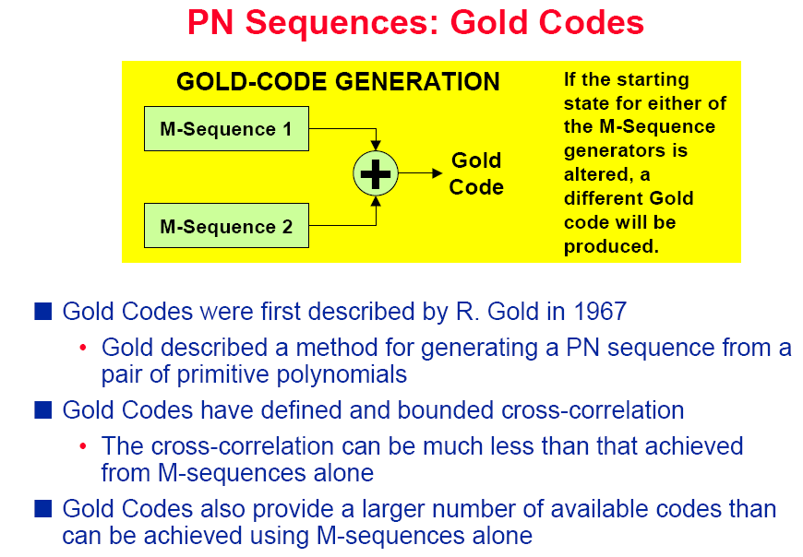

Slide 32
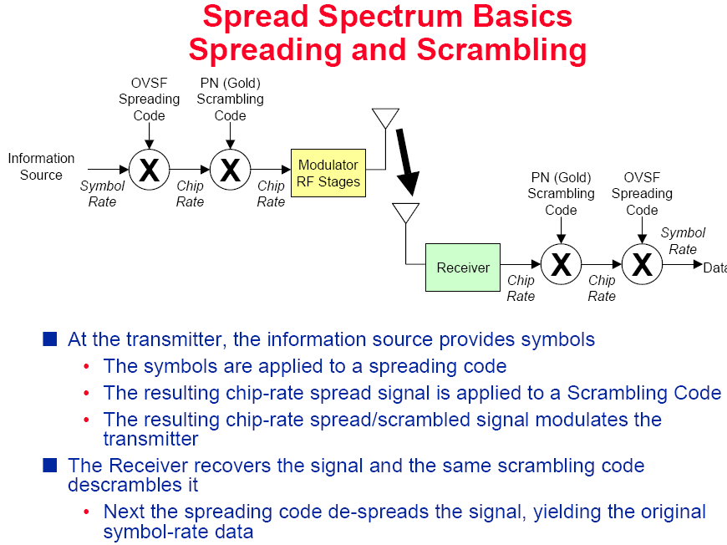

Slide 33
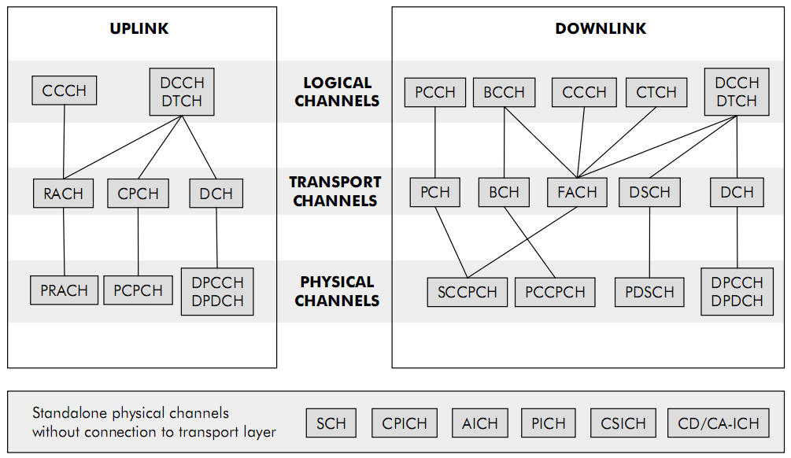
Mapping between Logical, Transport and Physical channels

Slide 34
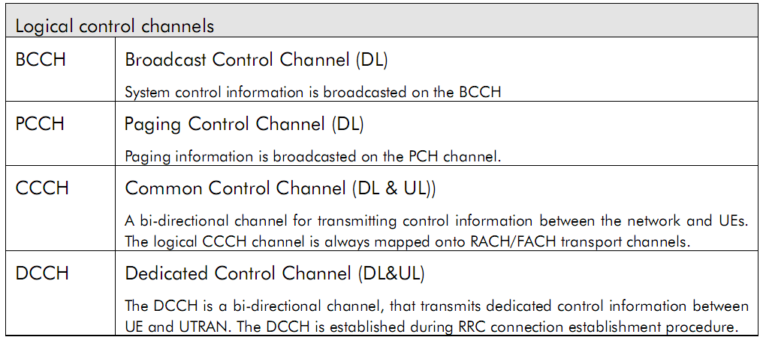
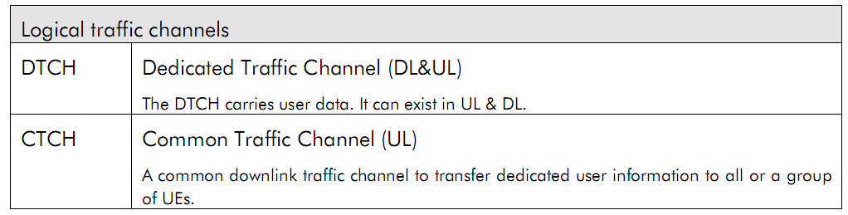

Slide 35
Transport Channels
In WCDMA there exists two types of transport channels:
  Dedicated Channels (DCHs)
    Resources are reserved for a single user only (continuous and independent from the DCHs of other UEs)
  Common channels
    Resources are shared between users
The main transport channels used for packet data transmissions in WCDMA are called
  DCH
  Forward Access Channel (FACH)

Slide 36
Transport Channels
DCH is used to carry
  User data
  All higher layer control information, such as handover commands
DCH is characterized by features such as
  Fast power control
  Soft handover
  Fast data rate change on a frame-by-frame basis is supported in the uplink
  In the downlink data rate variation is taken care of either with a rate-matching operation or with Discontinuous Transmission (DTX) instead of varying spreading factor frame-by-frame basis

Slide 37
Transport Channels
If downlink rate matching is used then data bits are either
  Repeated to increase the rate
  Punctured to decrease the rate
With DTX the transmission is off during part of the slot
FACH is a downlink transport channel used to carry
  Packet data
  Mandatory control information, e.g. to indicate that random access message has been received by BTS
Due to the reason that FACH carries vital control information FACH has to have such a low bit rate that it can be received by all UEs in the cell

Slide 38
Transport Channels
However, there can be more than one FACH in a cell which makes it possible to have higher bit rates for the other FACHs
The FACH does not support fast power control
In addition to FACH there are five different common channels in WCDMA:
  Broadcast Channel (BCH)
    Used to transmit information specific to the UTRA network or for a given cell, e.g. random access codes
    Channel needs to be reached by all UEs within the cell
  Paging Channel (PCH)
    Carries data relevant to the paging procedure, i.e. when the network wants to initiate communication with the terminal
    Terminals must be able to receive the paging information in the whole cell area

Slide 39
Transport Channels
  Random Access Channel (RACH)
    Uplink transport channel intended to be used to carry control information from the terminal, such as requests to set up a connection
  Uplink Common Packet Channel (CPCH)
    Extension to the RACH channel that is intended to carry packet-based user data in the uplink direction
  Dedicated Shared Channel (DSCH)
    Carries user data and/or control information; it can be shared by several users

Slide 40
Transport Channels
From the common channels DSCH was optional feature that was seldom implemented by the operators and later replaced in practice with High Speed Downlink Packet Access (HSDPA)
  3GPP decided to take DSCH away from Release 5 specifications onwards
  Also CPCH has been taken out of the specifications from Rel’5 onwards as it was not implemented in any of the practical networks

Slide 41
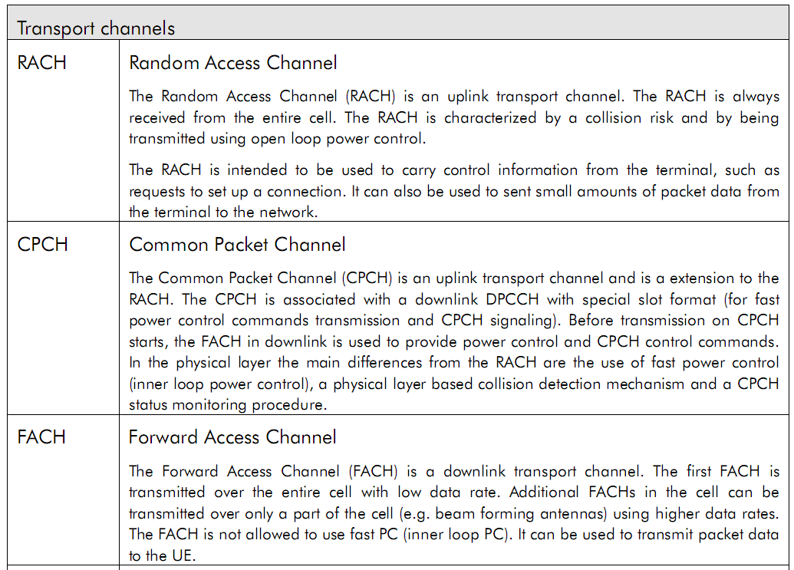

Slide 42
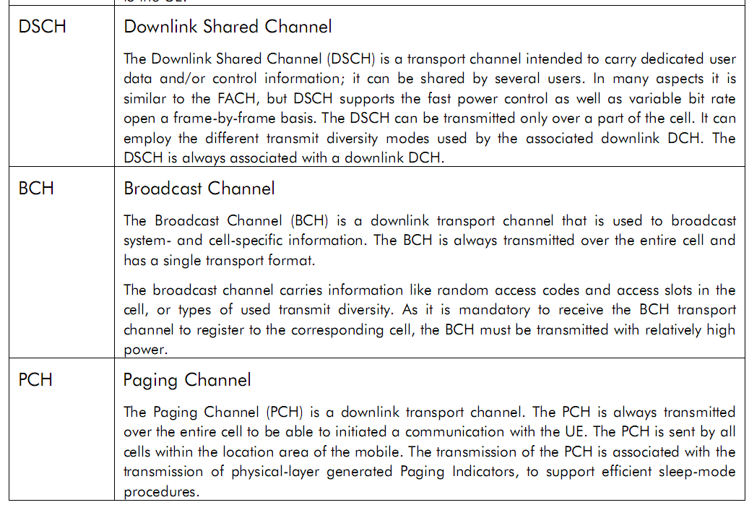

Slide 43
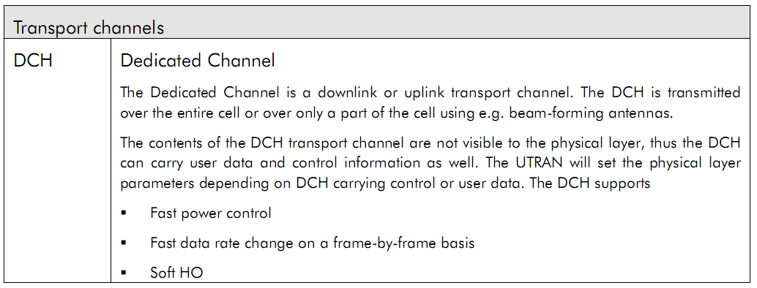

Slide 44
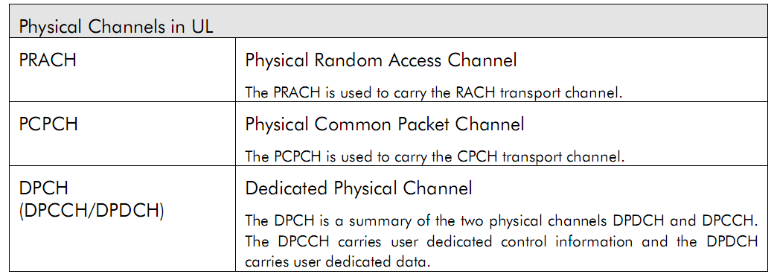

Slide 45
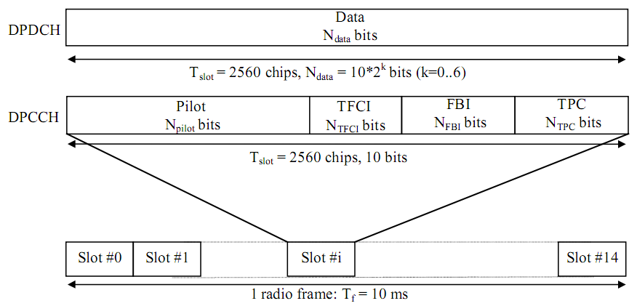
Frame structure for uplink DPDCH/DPCCH

Slide 46
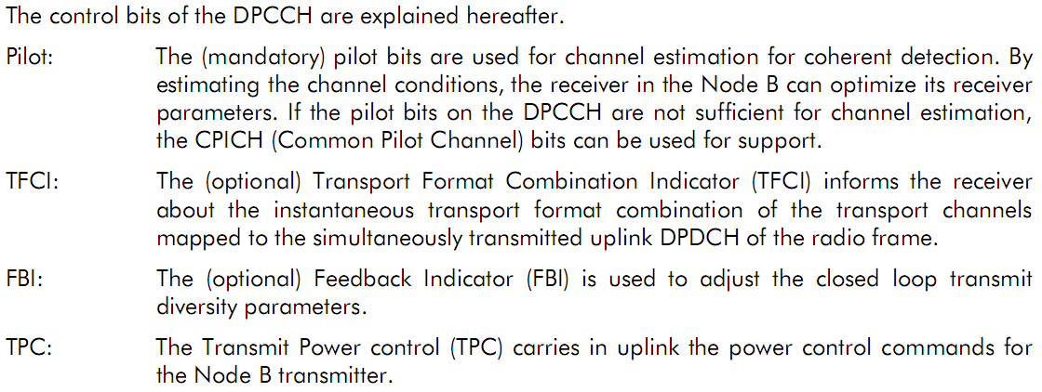

Slide 47
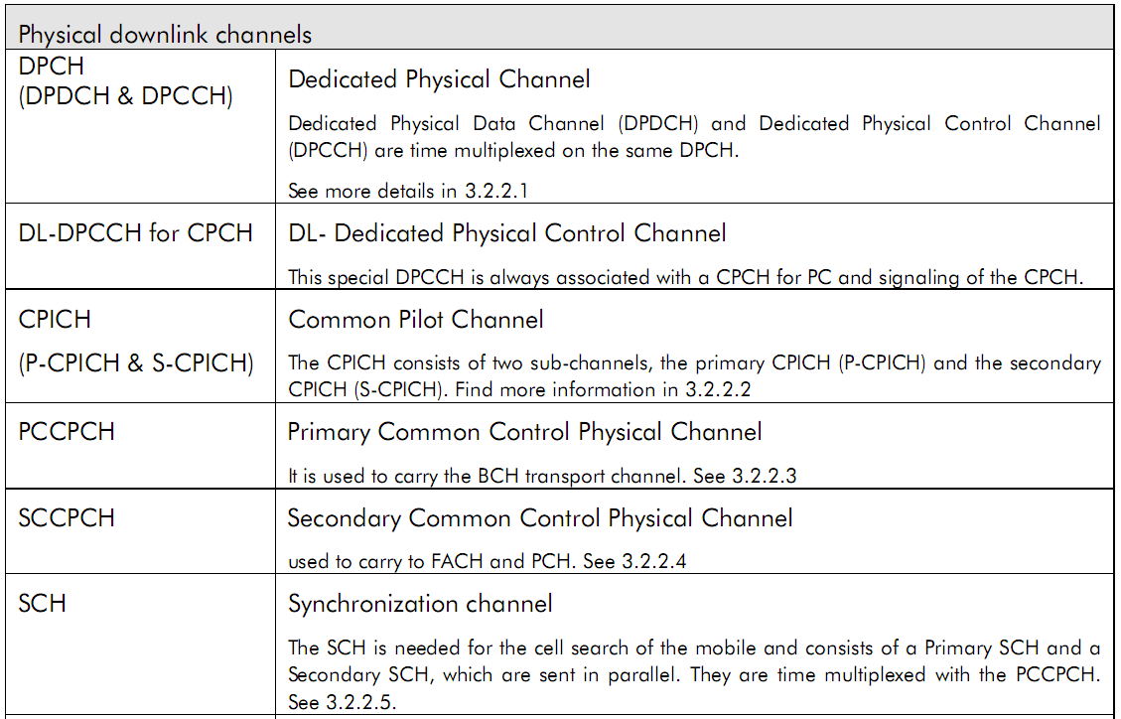

Slide 48
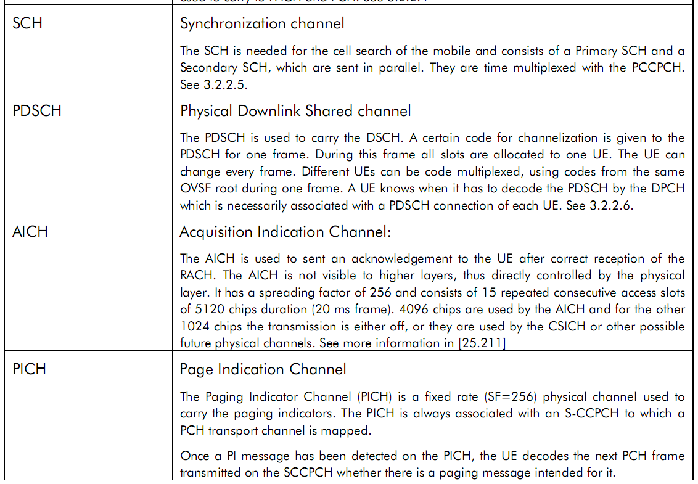

Slide 49
